Slide 1
cin, cout, getline
Slides by Varick Erickson
© Varick Erickson

Slide 2
Objectives
Understand the basic usage for namespace and how it relates to std functions and constants
Apply cout for basic use cases
Apply cin for basic use cases
Apply getline for basic use cases
Know when to use cin instead of getline and vice versa

Slide 3
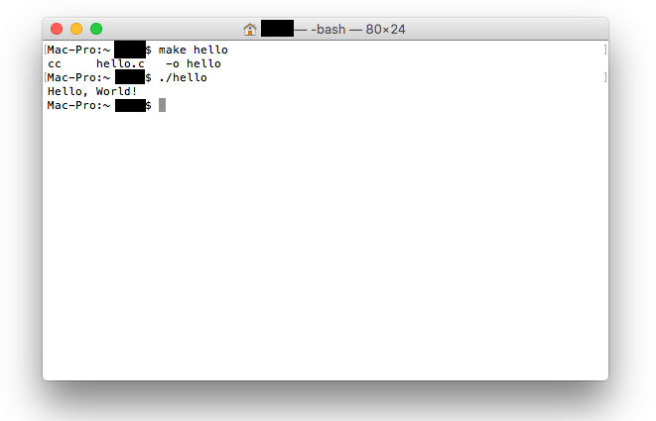
Basic Input and Output
A terminal or console is one of the simplest and most often used method of interacting with a program. If you are Windows, Powershell or cmd can be used.
If you are in MacOS or Linux, then you can use a Terminal window

Slide 4
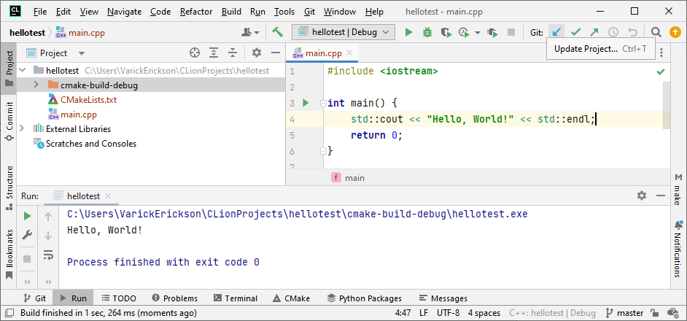
Basic Input and Output
In most cases, if you are developing in an IDE like CLion, then a terminal will be made available to you directly in the IDE

Slide 5
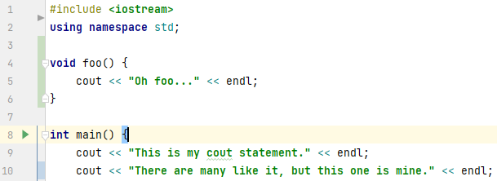
iostream
iostream → Input Output Stream
In order do basic input and output to the terminal, you will use the iostream library.

Slide 6
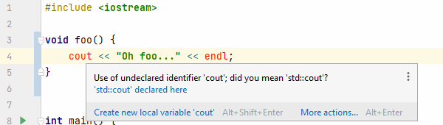
namespace
Namespace is a feature of C++ that allows multiple libraries to define functions with the same name.
A more detailed explanation of namespace is available in the md file.
TLDR Version Put using namespace std; at the beginning of your program.
Notes:
FYI… Some people don’t like putting “using namespace std;” globally at the beginning of the program. Instead, some opt to just put “using namespace std;” within the function scope as needed. For our case and in CS301, putting the namespace globally is fine.

Slide 7
cout
cout << "This is my cout statement." << endl; cout << "There are many like it, but this one is mine." << endl;
cout << "There are " << 5 << " apples. Pi is approximately " << 3.14 << "." << endl;
endl puts a newline at the end
cout will automatically convert primitive types (ie int, float, etc) to a printable string

Slide 8
Escape Characters
cout << endl << "Notice that \"\\n\" and endl both provide a new line." << "\n" << endl;
Certain characters require use an escape character
These characters typically start with \
If you want to display “, then you will use the escape character \”
https://en.cppreference.com/w/cpp/language/escape
Useful/Common Escape Characters:
\n newline
\t tab
\” double quote
\\ backslash

Slide 9
cin
string name; cout << "What is your name? "; cin >> name;
int speed; cout << "What is the average velocity of an unladen swallow? "; cin >> speed;
cin will automatically convert user input based on the variable type
The conversion only works for primitives (i.e., int, float, string, etc)

Slide 10

cin
string a, b; cout << "a = "; cin >> a; cout << "b = "; cin >> b; cout << "a + b = " << a + b << endl;
Assume you enter 5 for a and 3 for b.
What is the output?
Notes:
I suggest you demo this live
Output would be a + b = 53
Watch out for types

Slide 11
int speed; string name, quest; cout << "What is your name? "; cin >> name; cout << "What is your quest? "; cin >> quest; cout << "What is the average velocity of an unladen swallow? "; cin >> speed;

Slide 12
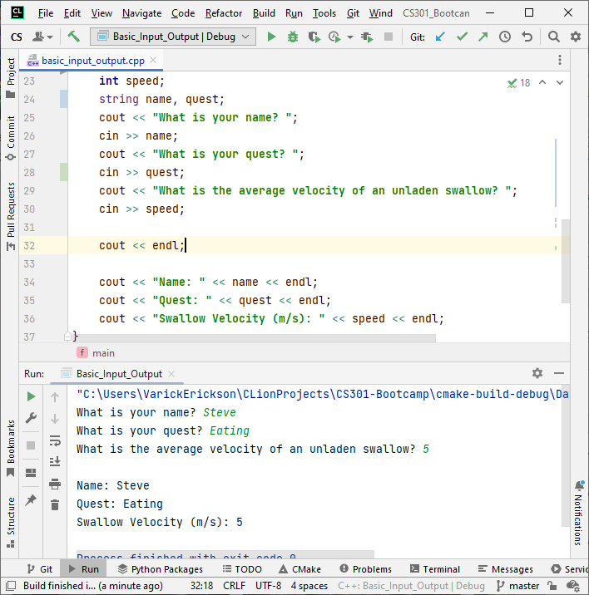
Notes:
Start with this to demo

Slide 13
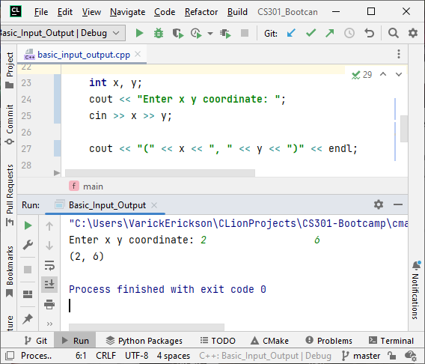
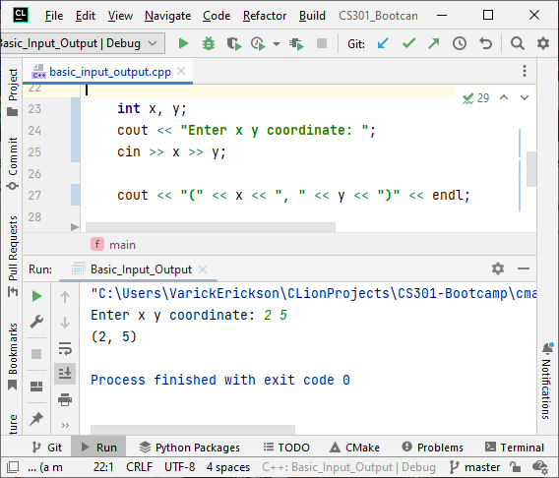
cin can be very convenient to get multiple values
cin will delimit user inputs using whitespace
Notice that cin ignores all white space between inputs
delimit → separate
cin ignores whitespace

Slide 14
Both of these are the same
cout << “Enter x, y, z: “;
cin << x;
cin << y;
cin << z;
cout << “Enter x, y, z: “;
cin << x << y << z;

Slide 15
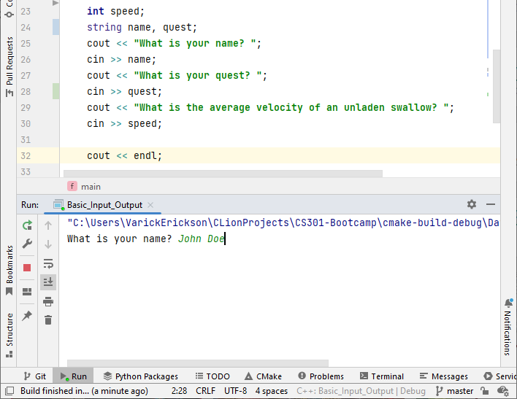
What if we input “John Doe”?
Notes:
Demo what happens when you input “John Doe”

Slide 16
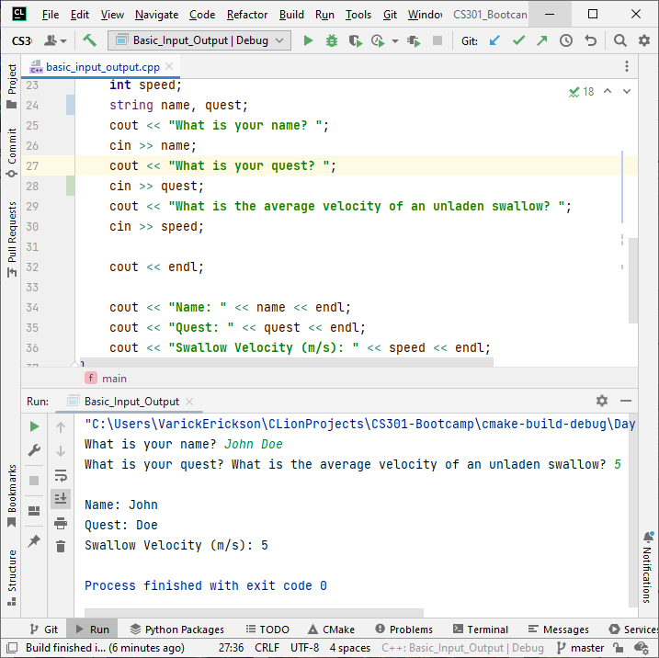
It seems to “skip over” the second question
Notice that name stores John and quest stores Doe
cin uses “whitespace” to delimit input values
“John Doe\n”
space
newline
delimit → separate

Slide 17
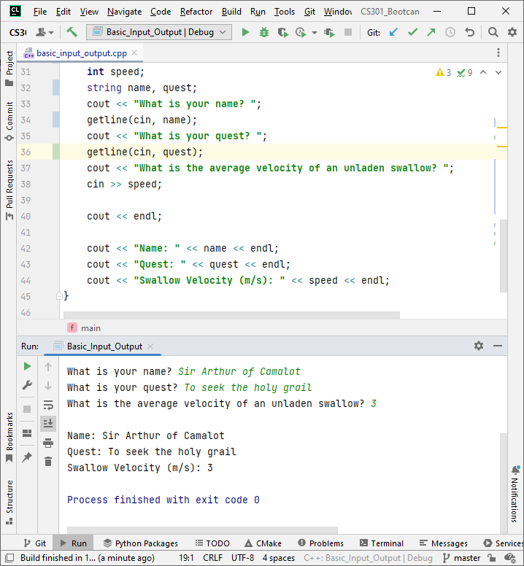
getline
In some instances, you do NOT want input to be delimited
In this case, you can use getline
The variable must be a string
getline(cin, variable);

Slide 18
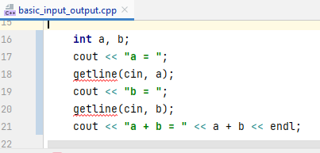
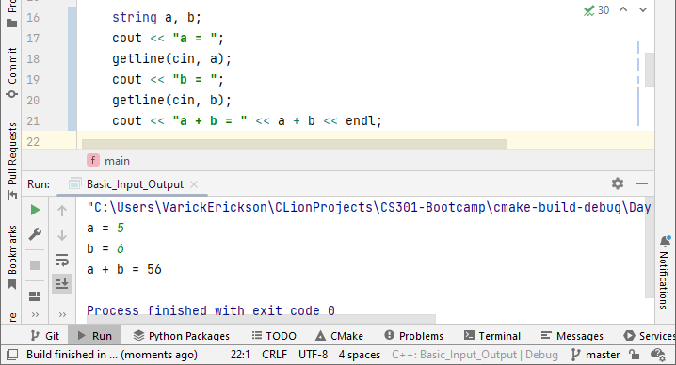
getline not good for numerical inputs
Since getline only works for strings, it does not work well for numerical inputs

